Slide 1
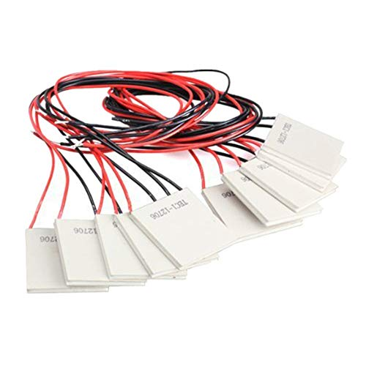
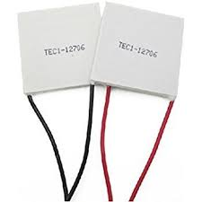
Peltier Cooling
Team Leaders:
Victor Furtado
Hugo Lopez
Team Members:
Suryateja Addagarla
Minh Chau
Xin Hu
Yifei Li
Jesse Llanos
Joseph Luya
Kerry Ollivierre
Eniola Onitiju
Liwei Zhang

Slide 2
Problem Statement
Conventional HVAC&R systems pose a significant threat to the environment by dumping harmful gases into the atmosphere through the use of refrigerants. The Peltier team proposes a thermoelectric based system for building cooling and heating applications. The system will consist of Thermoelectric Modules (TEMs) embedded into the ceiling envelope of the proposed test building environment, which will provide cooling and heating through radiation and convection. The project will adhere to the ASHRAE 55 thermal comfort standards. The final product will be utilized for educational purposes in the Heat Transfer laboratory at the Florida Institute of Technology for teaching principles of radiative cooling and heating, as well as the Peltier Effect.

Slide 3
Motivation
According to the US Energy Information Administration (EIA), energy use in the building sector accounts for 20% of global energy consumption.
In 2018, 40% of the energy consumed in the United States came from buildings, which is equivalent to 40 Quadrillion British Thermal Units (BTU). Additionally,
Cooling and heating alone account for over half of the total energy consumption in buildings.
Emissions due to refrigerants have more than tripled as a result of a dependence on R-410 in air conditioners in the past 8 years.
The need for innovative building cooling and heating that doesn’t rely on these harmful refrigerants will improve both energy efficiency and environmental concerns by doing so.

Slide 4
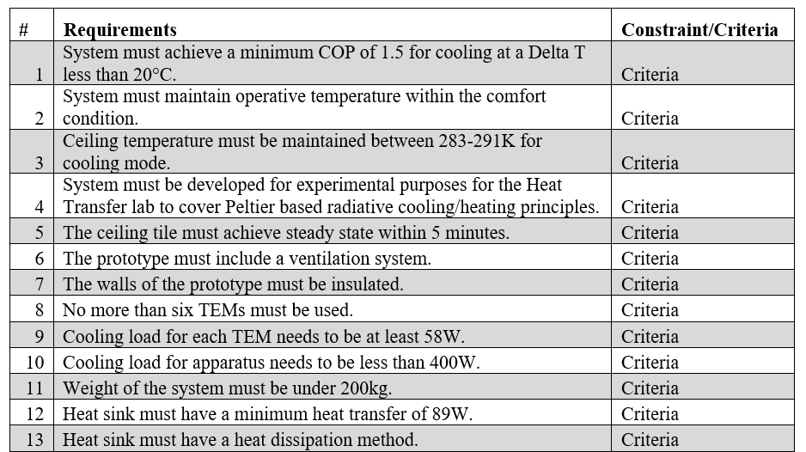
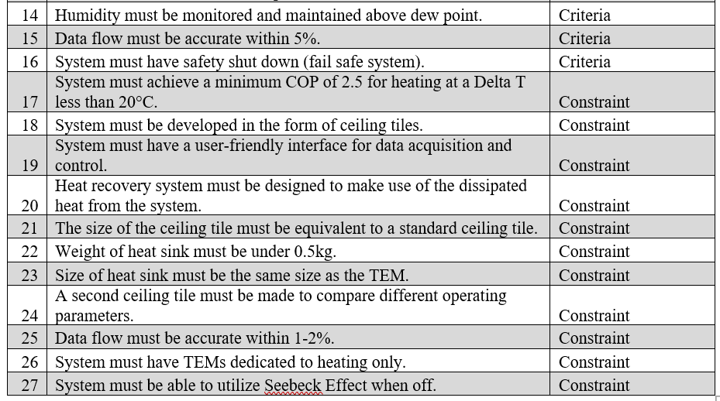
Requirements
Notes:
Humidy below65%
Seebeck when running

Slide 5
Impact
Notes:
picture

Slide 6
Major Aspects of Thermoelectric Modules
Advantages
Disadvantages
No refrigerant
No moving parts
High controllability
Temperature accuracy
Can be powered by PV panels
Lower COP than conventional HVAC systems

Slide 7

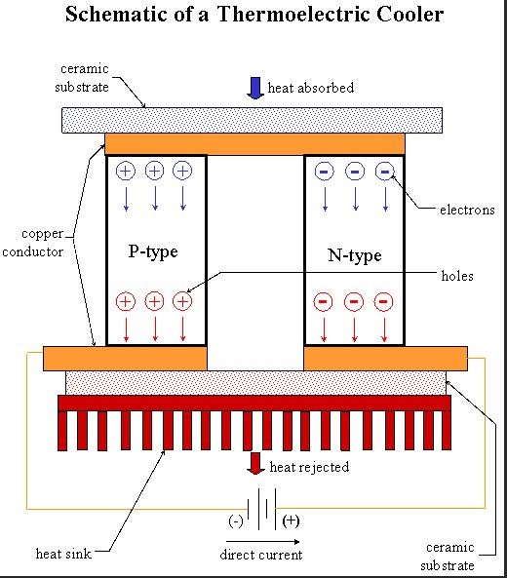
Peltier Effect
Definitions
The effect of heat being absorbed or emitted with an input current, creating a temperature difference between the two surfaces of a TEM.
The Seebeck effect is simply a reverse process of the Peltier Effect.
Joseph Luya

Slide 8
Major Design Aspects
Energy Efficiency
Coefficient of Performance
Heat Sink Performance
Thermal Comfort
Ceiling Temperature
Ceiling Materials
3. Product Design
Ceiling Configuration
Test Building Environment
Control System
4. Bill of Materials
5. Future Works

Slide 9

1. Energy Efficiency
Definitions
Energy Efficiency involves ways of minimizing energy use for a system.
Divided into two categories:
Coefficient of Performance for TEM.
Heat Sink Performance.
Eniola Onitiju

Slide 10

1. Energy Efficiency: Coefficient of Performance
What is COP?
COP is the ratio of useful energy over the work required.
A COP value of 1 means a 100% efficiency
Standard HVAC systems have a typical COP range of 2 - 4
Eniola Onitiju
Notes:
Useful heat transfer rate
Motion to work

Slide 11
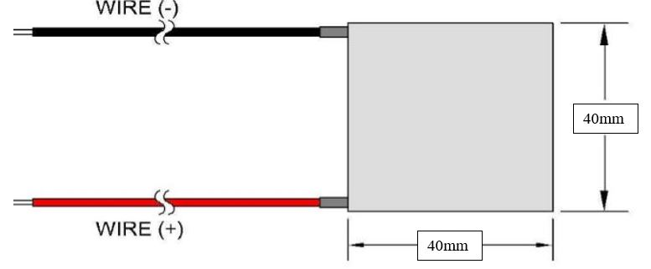
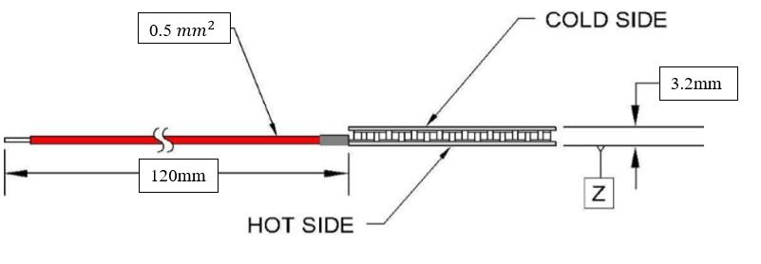
1. Energy Efficiency: Coefficient of Performance
Finalized TE Module selection
HP-199-1.4-0.8
Power output: 172W
Size: 40 x 40 x 3.2 mm
Cost: $37.80 per module
https://tetech.com/wp-content/uploads/2019/03/HP-199-1.4-0.8.pdf
Eniola Onitiju

Slide 12
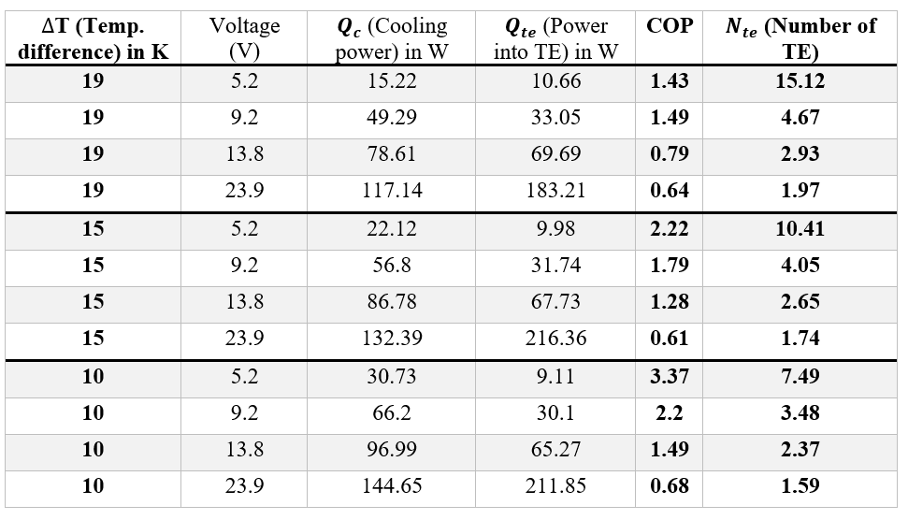
1. Energy Efficiency: Coefficient of Performance
COP Calculation
To determine the COP, Qc, Input power, and No. of TEM needed.
Input parameters: Voltage, Current, and dT (Temperature difference).
Table showing COP calculation for the selected High Powered TE Module (TEM)
Eniola Onitiju

Slide 13
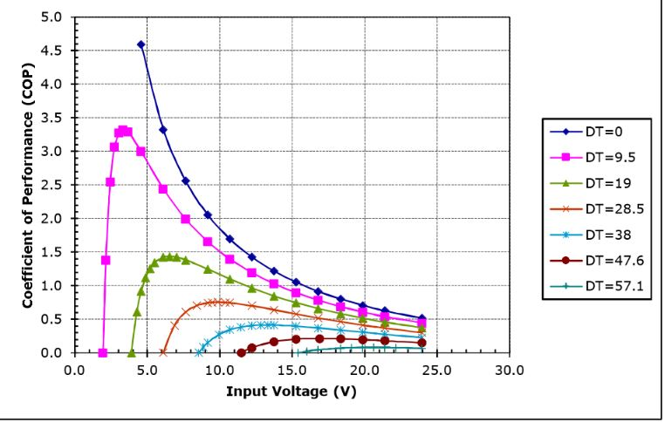
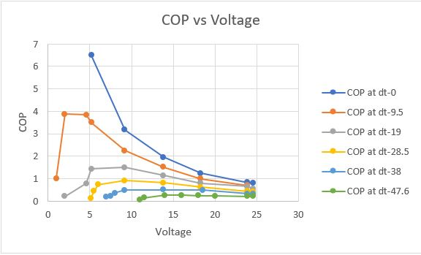
1. Energy Efficiency: Coefficient of Performance
COP comparison
Comparison between manufacturers data and calculated data for HP-119-1.4-0.8 TEM
Eniola Onitiju

Slide 14
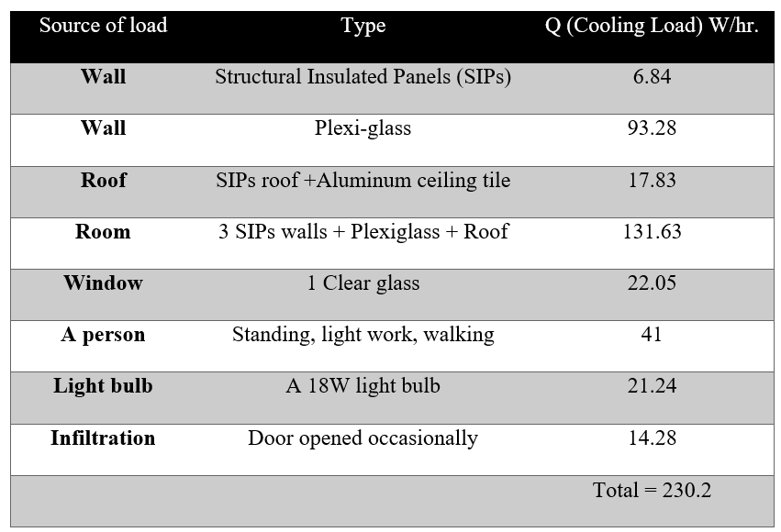
1. Energy Efficiency: System Load
Cooling load Estimation
Cooling load is the heat needed to be removed from the room.
Room dimensions : 1.22 x 1.22 x 1.53 m (LxWxH).
Walls: 2in. Structural insulated Panels (3 SIPs) +1 Plexiglass Panel.
Table showing the Total Cooling Load from various sources in our system
Eniola Onitiju

Slide 15
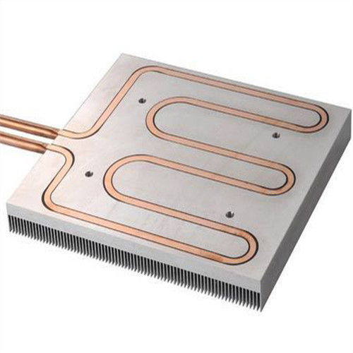
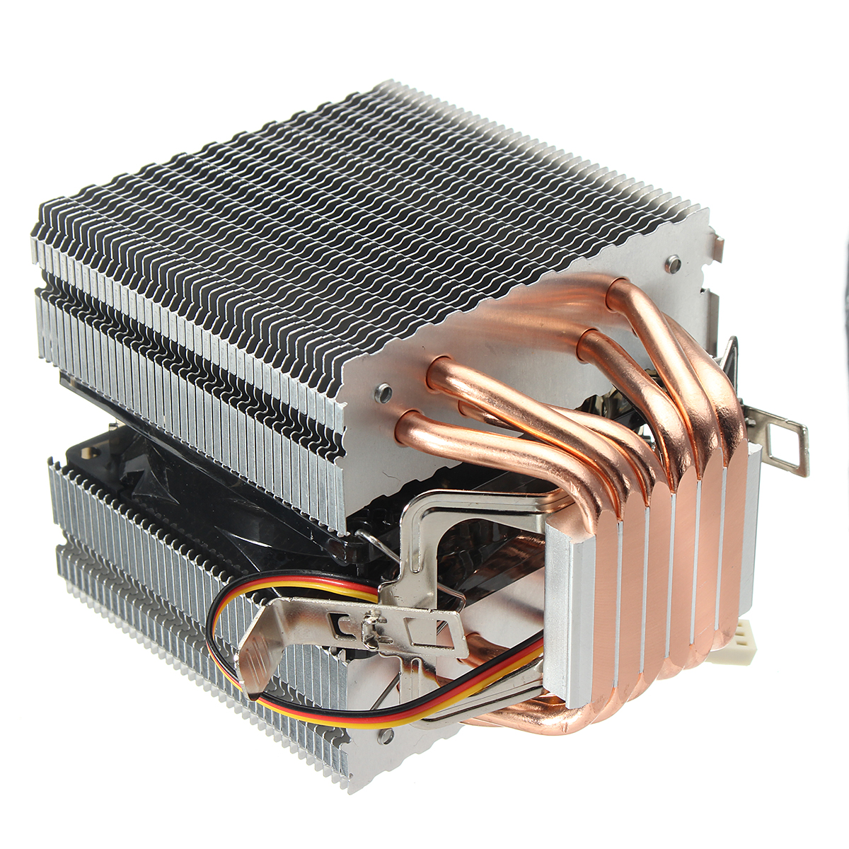
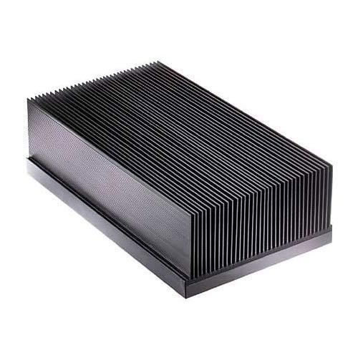
1. Energy Efficiency: Heat sinks
Heat Sinks
A heatsink is a thermal Reservoir to aid in the dissipation of heat.
TE modules need a set temperature difference to operate at an optimal COP.
A heatsink capable of maintaining this set temperature difference is needed.
https://3.imimg.com/data3/VH/BC/MY-7418038/bonded-fin-heat-sinks-500x500.jpg
https://www.aluminiumdiecastingparts.com/photo/pl13022742-water_cooled_liquid_panel_copper_pipe_heat_sink_aluminum_extrusion_heatsink.jpg
https://alexnld.com/wp-content/uploads/2017/10/916dd3c4-d124-4f42-a414-f3283a19ad6f.jpg
Liwei Zhang

Slide 16
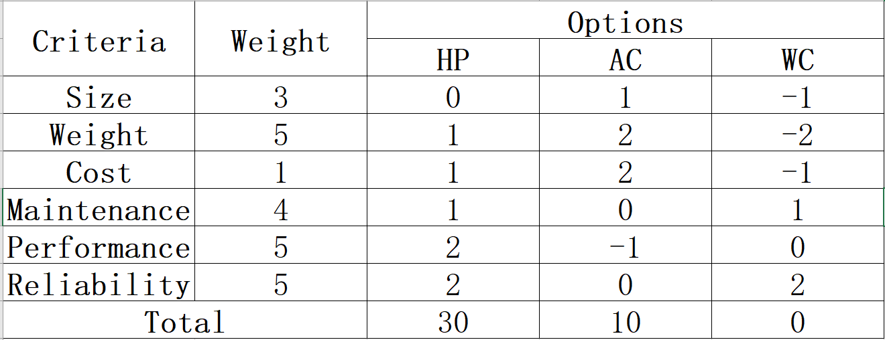
Energy Efficiency: Heat sinks
Decision matrix
HP: Heat Pipes AC: Air cooled WC: Water Cooled
Liwei Zhang

Slide 17
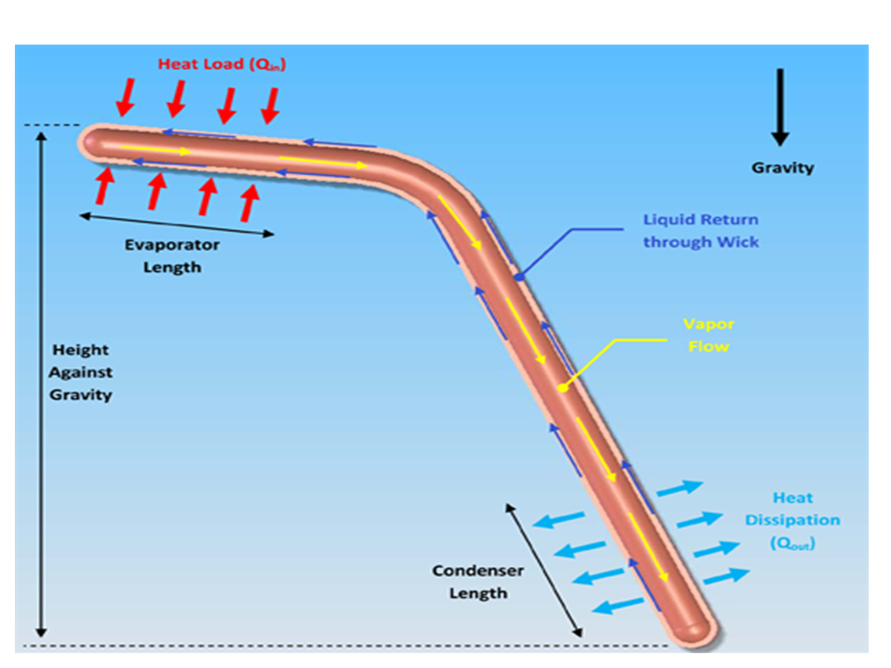
1. Energy Efficiency: Heat sinks
Heat Pipe Schematic
https://www.1-act.com/wp-content/uploads/2013/01/Slide1.bmp
Liwei Zhang

Slide 18

Energy Efficiency: Heat sinks
Heat Pipe Selection
NOCTUA NH-L9x65
Power dissipation 140W or less
Cost: $ 49.95
Dimensions: 0.065X0.095X0.095m
Weight: 413g
https://noctua.at/en/products/cpu-cooler-retail/nh-l9x65
Liwei Zhang

Slide 19
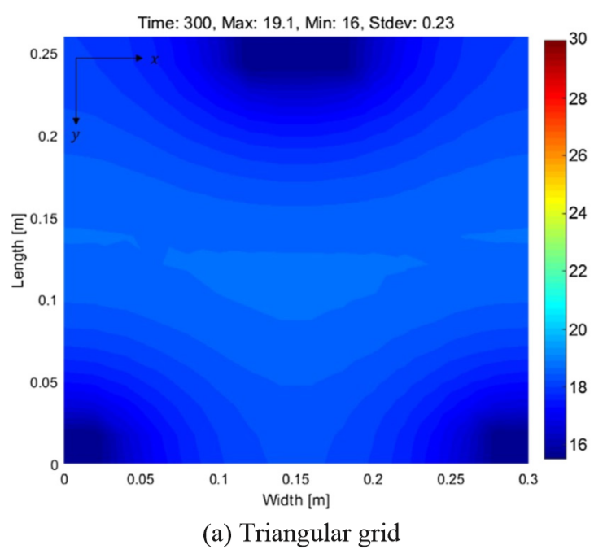
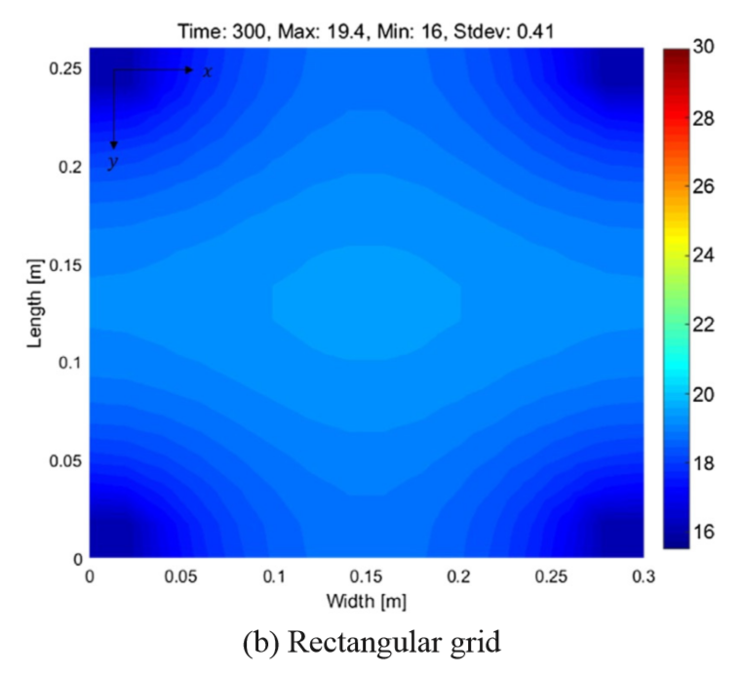
Energy Efficiency: Heat sinks
Arrangement and Spacing
Lim, Hansol, et al. “Thermoelectric Radiant Cooling Panel Design: Numerical Simulation and Experimental Validation.” Applied Thermal Engineering, vol. 144, 2018, pp. 248–261.,
Liwei Zhang
Notes:
Heat pipe, fan at back, plate with PCM

Slide 20
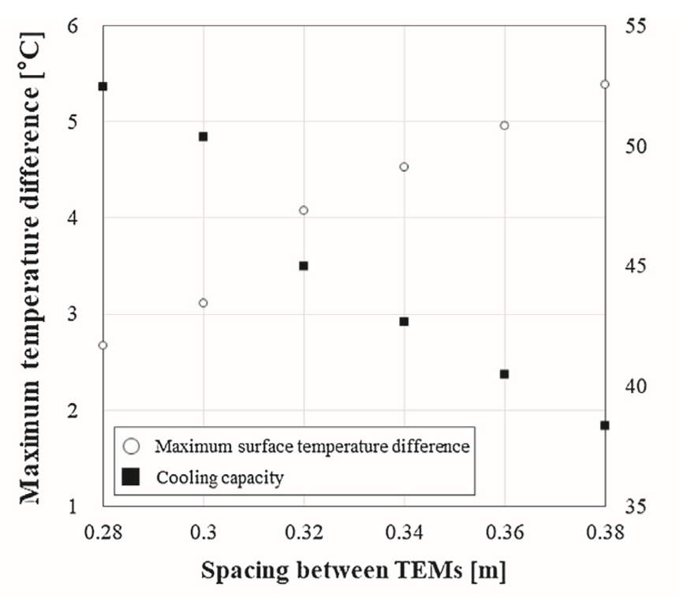
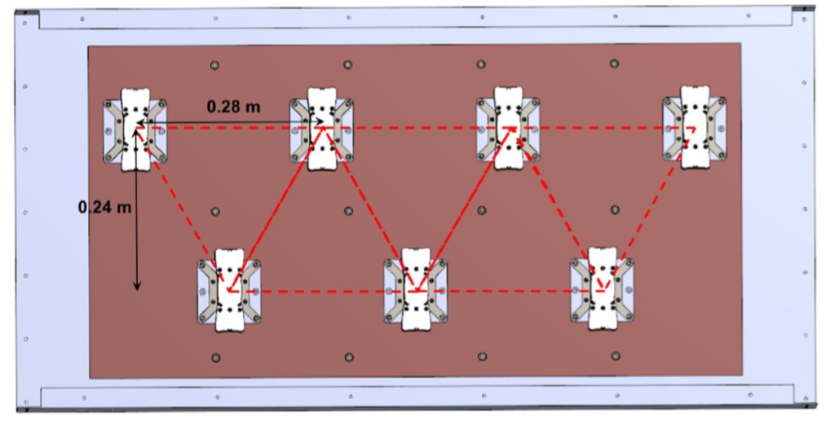
Energy Efficiency: Heat sinks
Arrangement and Spacing
Configuration of TE models
Lim, Hansol, et al. “Thermoelectric Radiant Cooling Panel Design: Numerical Simulation and Experimental Validation.” Applied Thermal Engineering, vol. 144, 2018, pp. 248–261.,
Liwei Zhang
Notes:
Now we have the configuration of TE module to effectively cool the room, however, we still need to know the temperature we want to cool down.

Slide 21
2. Thermal Comfort: Major Aspects
Mean Radiant Temperature (MRT)
Recognizes the relationship occupants have with the surroundings via radiant heat transfer.
Operative Temperature
Average between air temperature and MRT.
Most requirements for thermal comfort are based on the operative temperature in a space.
Victor Rocha

Slide 22
2. Thermal Comfort: Recommended Standards
Temperatures
Dew Point
RH is 100% when dew point and the temperature are the same.
If the temperature drops, condensation will happen, damaging the materials used for ceiling, walls and floor.
Indoor air must be maintained at 293-298 K (68–76°F).
Relative humidity (RH) levels within the range of 20-60%.
Equivalent to a dew point of 268-289 K (24-60°F).
Victor Rocha

Slide 23
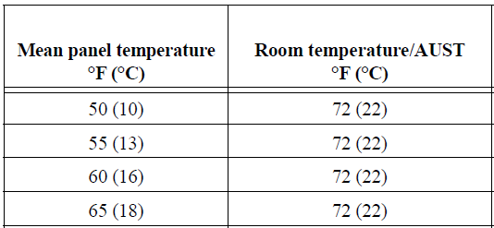
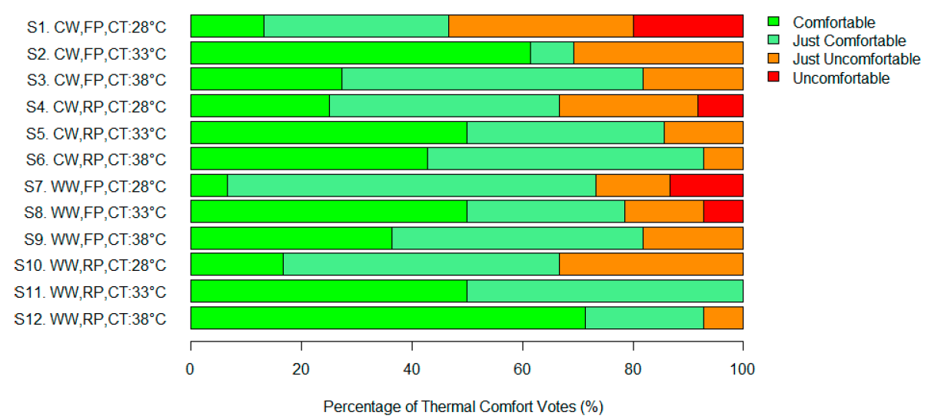
2. Thermal Comfort: Ceiling Temperature
Cooling Mode
Heating Mode
Reference: C.L. Conroy et al, Ceiling Radiant Cooling Panels as a Viable Distributed Parallel Sensible Cooling Technology Integrated with Dedicated Outdoor Air Systems, 2008
Reference: M. Reza Safizadeh et al, Experimental Evaluation of Radiant Heating Ceiling Systems Based on Thermal Comfort Criteria, 2018
Victor Rocha

Slide 24
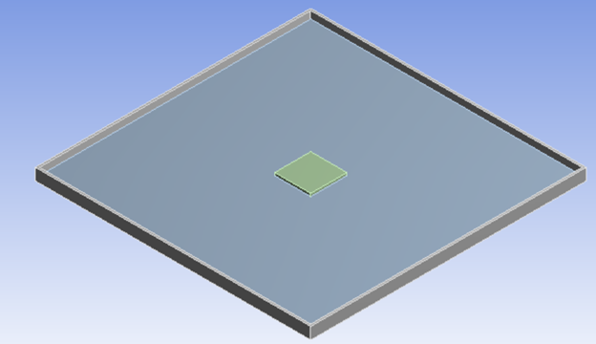
3. Product Design: Ceiling Analysis
Aluminum & PCM Ceiling Panel
Integrate the two configurations to optimize the efficiency of the system, combining the advantages of metal panels with PCM.
The combination of the two configurations allows the system to have a 56% improvement in COP.
Tan, Gang, and Dongliang Zhao. “Study of a Thermoelectric Space Cooling System Integrated with Phase Change Material.” Applied Thermal Engineering, Pergamon, 1 May 2015, www.sciencedirect.com/science/article/pii/S1359431115003981.
Notes:
3 minutes is realistic.
Reverse process

Slide 25
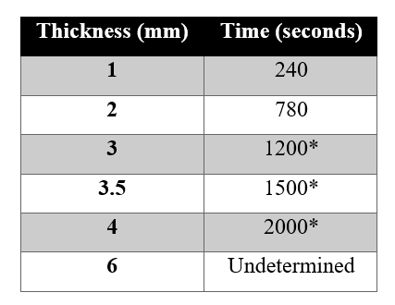
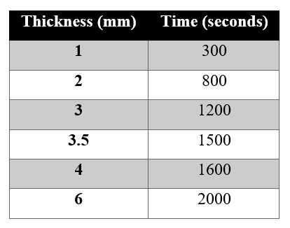
3. Product Design: Ceiling Analysis
PCM Thickness Analysis
Time to Reach Solid State
Time to Reach Liquid State
Notes:
3 minutes is realistic.
Reverse process

Slide 26
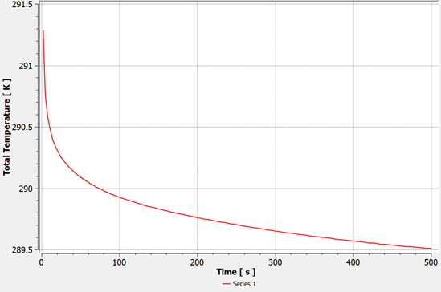
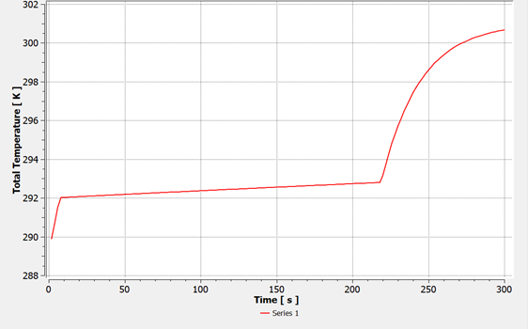
3. Product Design: Ceiling Analysis
Analysis for Final Ceiling Configuration
Operative Temperature achieved within 200 seconds.
Ceiling panel keeps the required temperature for 300 seconds.
Notes:
3 minutes is realistic.
Reverse process

Slide 27
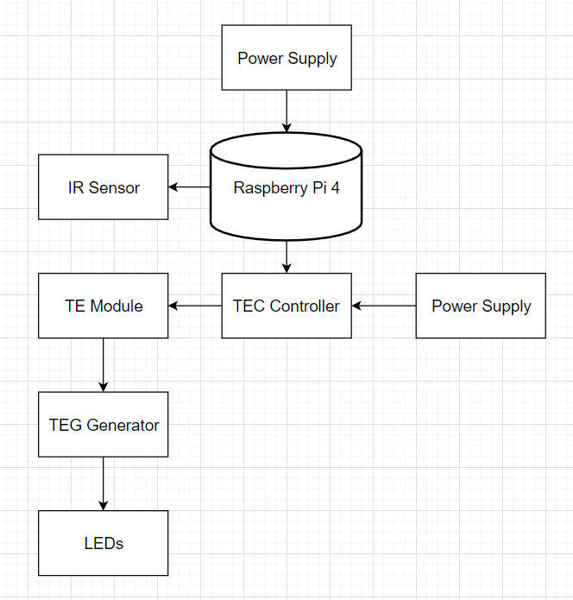
3. Product Design: Control System
Hardware Design
Notes:
What will be measured?
What is the rate?
Ex: tep of heat sink…(education purpose)

Slide 28
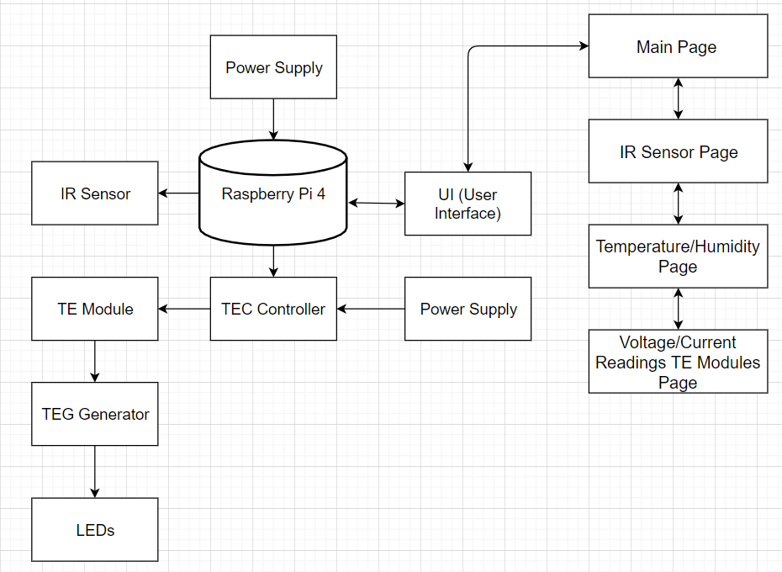
3. Product Design: Control System
Design Communication

Slide 29
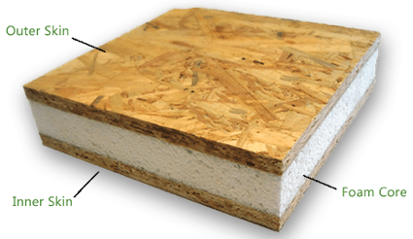
3. Product Design: Test Building Environment
Material
Dimensions
Source
Structural Insulated Panels:
Extremely strong
Energy efficient
Cost effective
High performance building system
R-value: 12
Thickness: 5.1 cm
Weight: 5.21 kg per square m
Total weight: 140 kg of SIPs
Innova Eco Building System
Notes:
3 minutes is realistic.
Reverse process

Slide 30
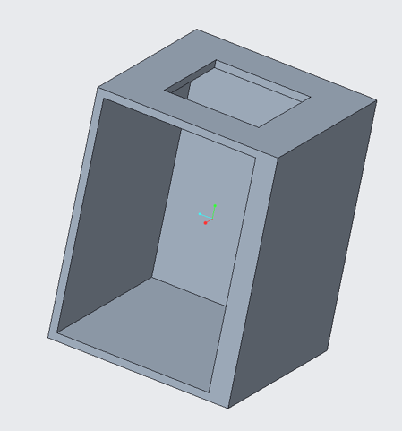
3. Product Design: Test Building Environment
Schematics
Materials
Dimensions
Structural Insulated Panels (SIPs)
Plexiglass
Length: 1.22 m
Width: 1.22 m
Height: 1.53 m
Notes:
3 minutes is realistic.
Reverse process

Slide 31
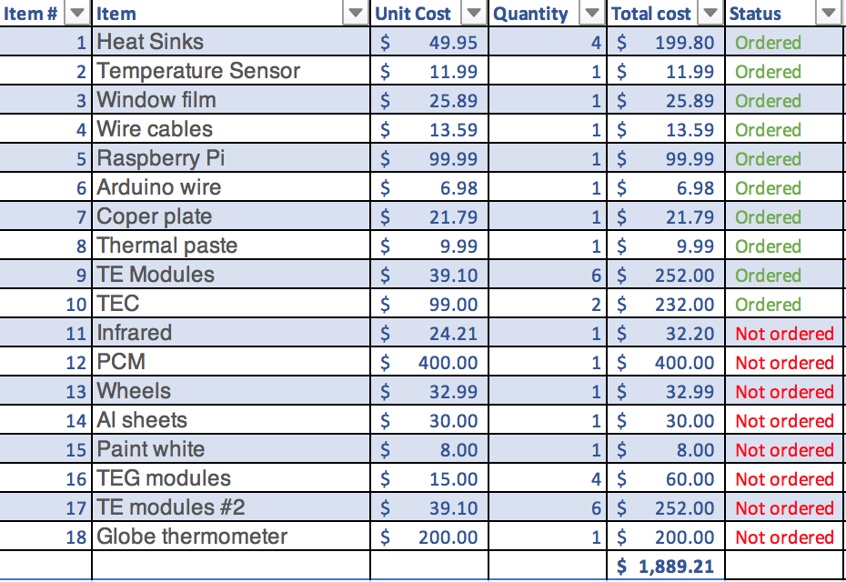
4. Bill of Materials
Notes:
3 minutes is realistic.
Reverse process

Slide 32
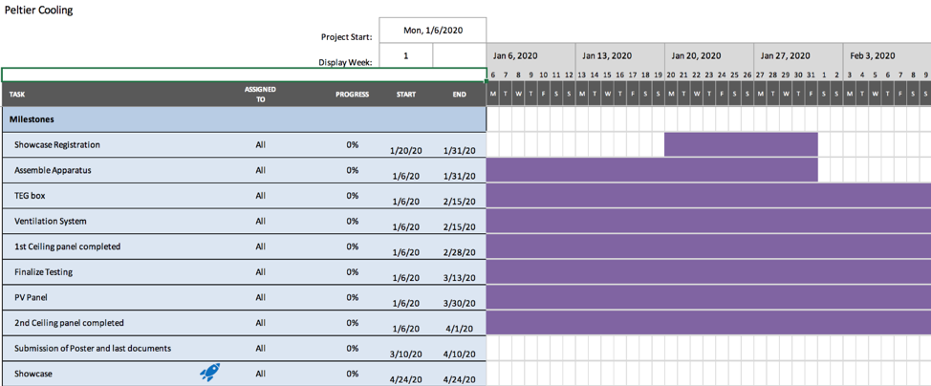
5. Future Works
Notes:
3 minutes is realistic.
Reverse process

Slide 33
Questions?

Slide 34
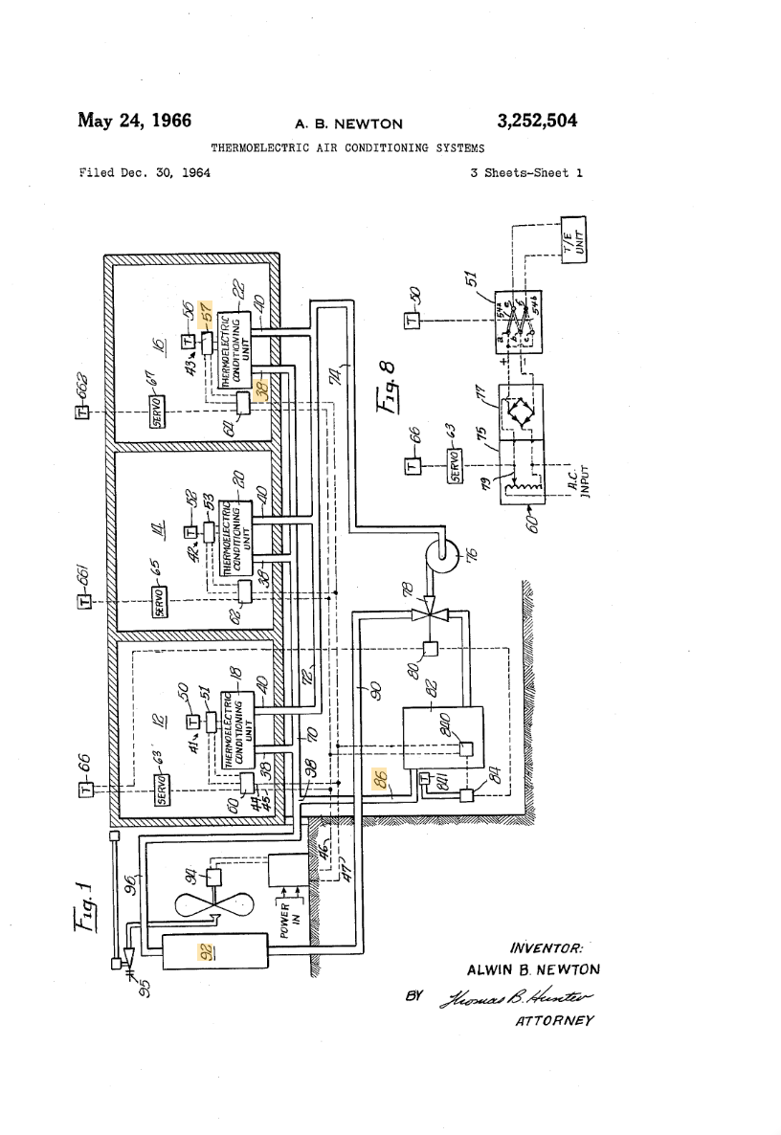
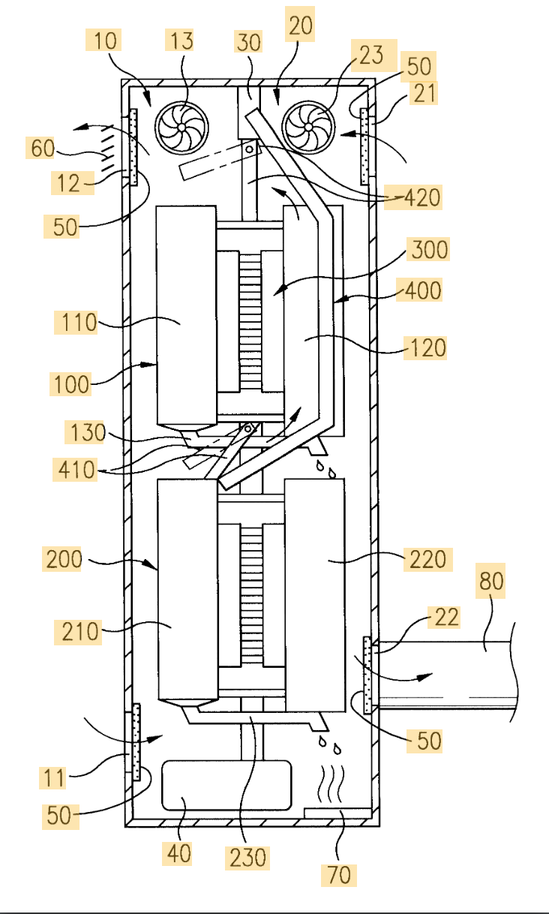
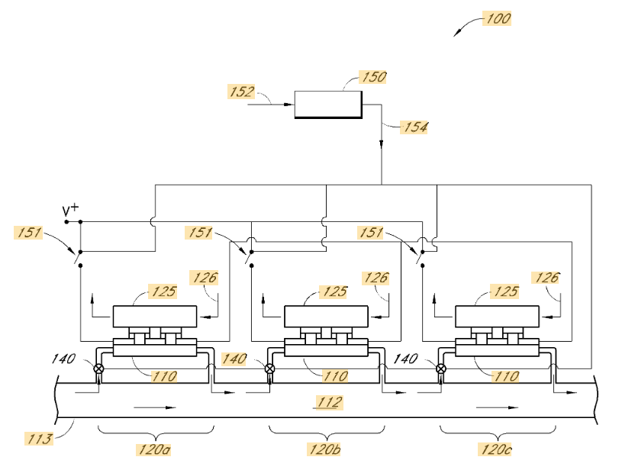
Patent Search

Slide 35
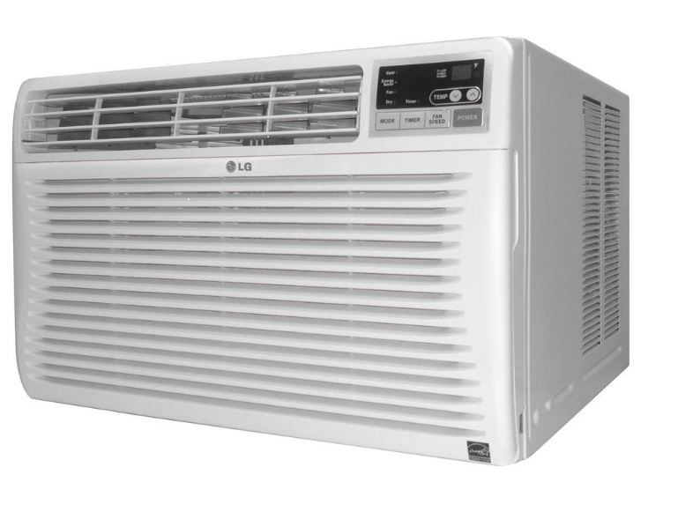
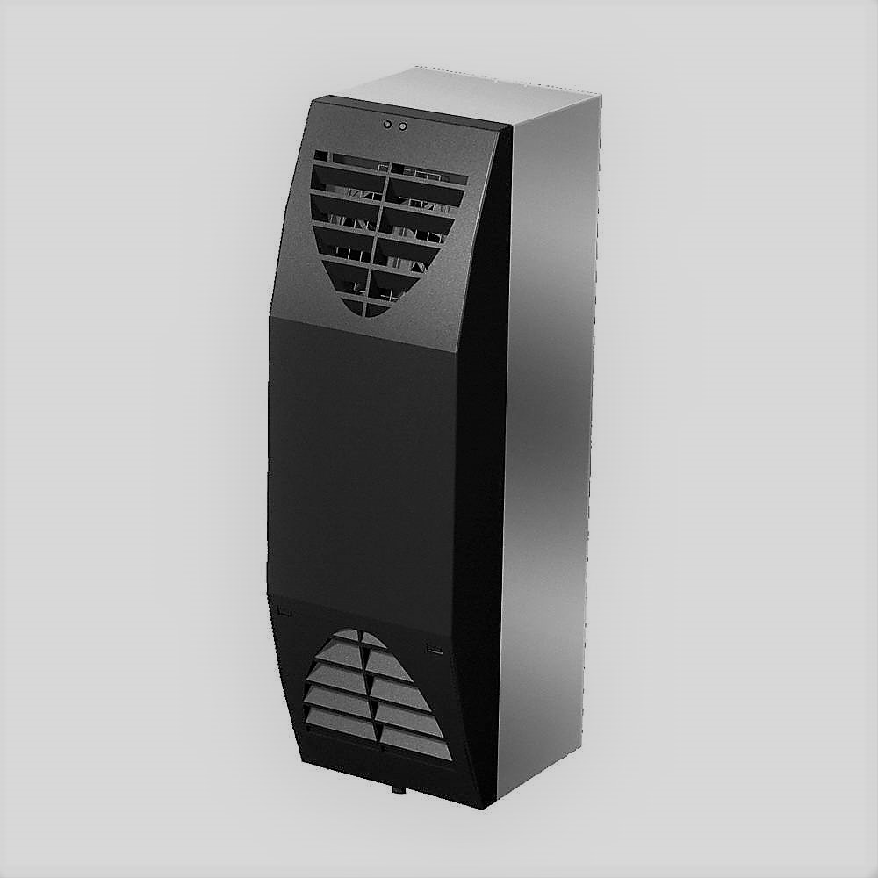
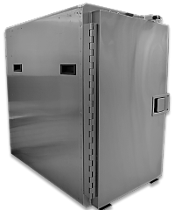
1. Energy Efficiency: Coefficient of Performance
Current State of the Art
Similar Air Cooling Units
HVAC air condItioner
TE enclosure coolers
Similar Peltier Based Units
TE enclosure coolers
TE refrigerators
TE wine coolers
HVAC AC unit
TE Enclosure AC unit
TE Refrigerator
Eniola Onitiju

Slide 36
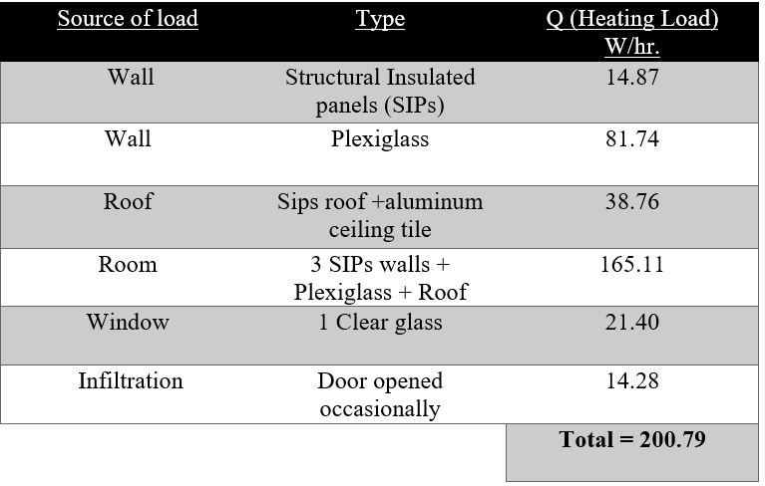
1. Energy Efficiency: System Load
Heating Load
Heating load is the heat to be supplied to the room.
Heat supplied to room during winter and cold nights.
Factors ignored: lighting, person, and solar radiation
Table showing the Total Heating Load from various sources in our system
Eniola Onitiju

Slide 37
2. Thermal Comfort: Definition
Environment Factors
Air Temperature
Humidity
Air velocity
Mean Radiant Temperature
Personal Factors
Clothing Insulation
Work Rate/Metabolic Heat
Victor Rocha

Slide 38
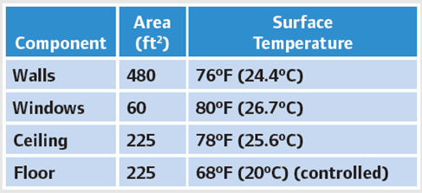
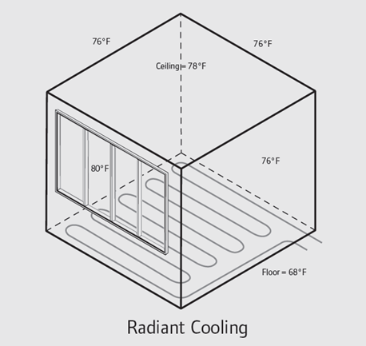
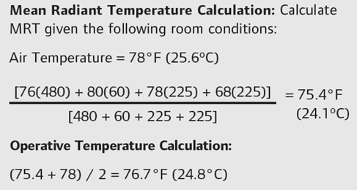
2. Thermal Comfort: Major Aspects
Case Study
Uponor, Inc. “Radiant Cooling Manual.” Radiant Cooling Systems, 2013, www.uponorpro.com/~/media/extranet/files/manuals.
Liwei Zhang

Slide 39
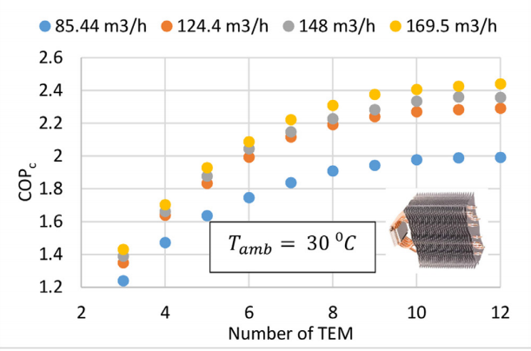
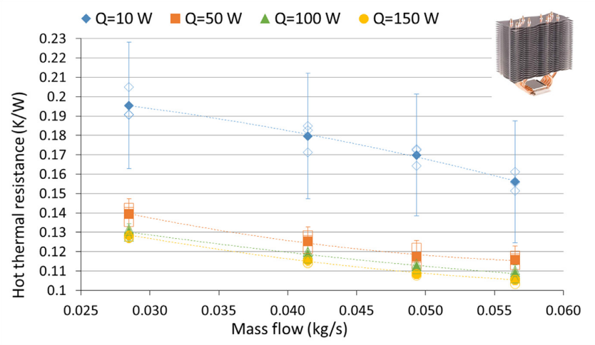
1. Energy Efficiency: Heat sinks
Heat pipe cooled
Aranguren, P., et al. “Heat Pipes Thermal Performance for a Reversible Thermoelectric Cooler-Heat Pump for a NZEB.” Energy and Buildings, vol. 187, 2019, pp. 163–172., doi:10.1016/j.enbuild.2019.01.039.
Liwei Zhang

